Slide 1
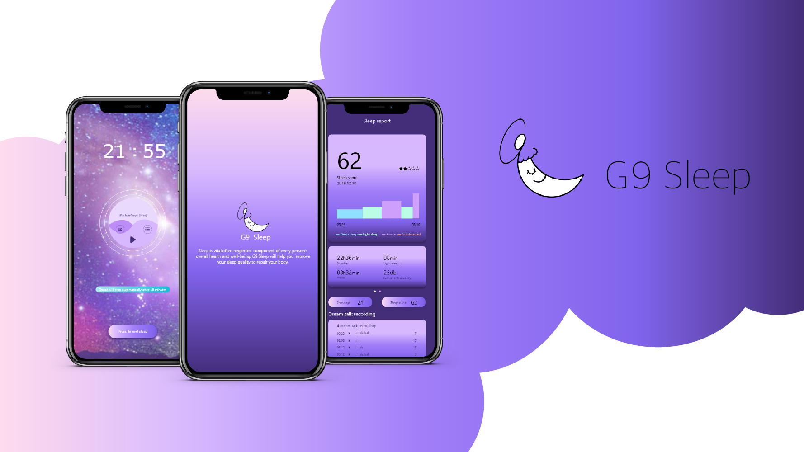

Slide 2
MARKET RESEARCH ON COMPETITOR PRODUCTS
APPLICATION
HEURISTIC EVALUATION
USER TESTS
APP PLANNING
02
Product introduction, description, performance, etc.
19
TABLE OF
CONTENTS
Advantages and disadvantages of the application, functional analysis
32
Expert Analysis On Several Sleeping Apps
36
User Tests on 'Sleep As Android' App
44
Ideas for customized sleeping app

Slide 3
01
Market Research on
Competitor Products
Product introduction, description, performance, etc.
2

Slide 4
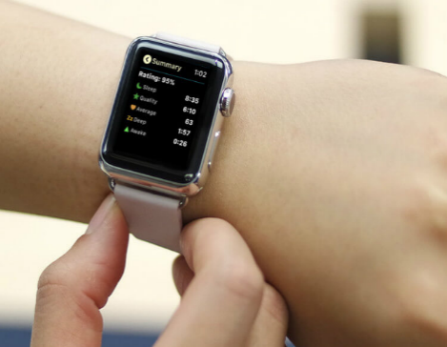
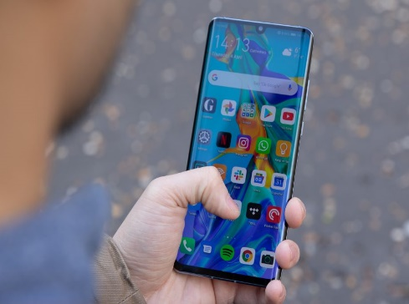
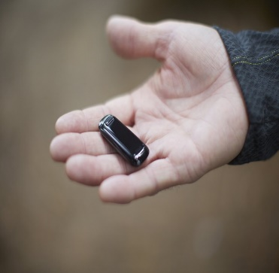
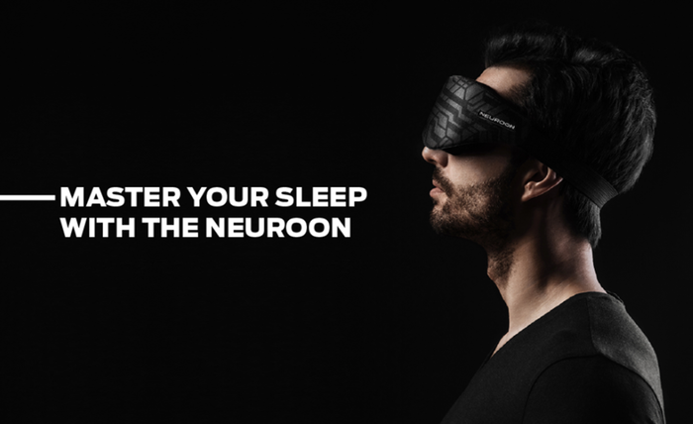
Leading Sleep Tracking Products
SMARTWATCH
SMARTPHONE
WIRELESS ACTIVITY TRACKER
SLEEP MASK
3

Slide 5
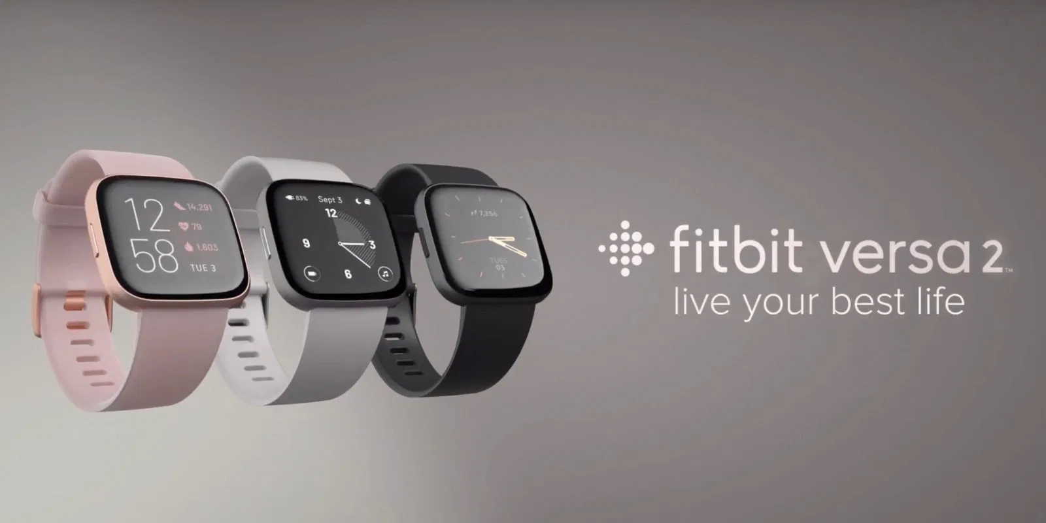
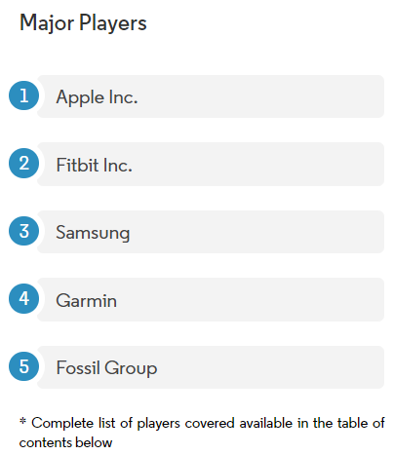
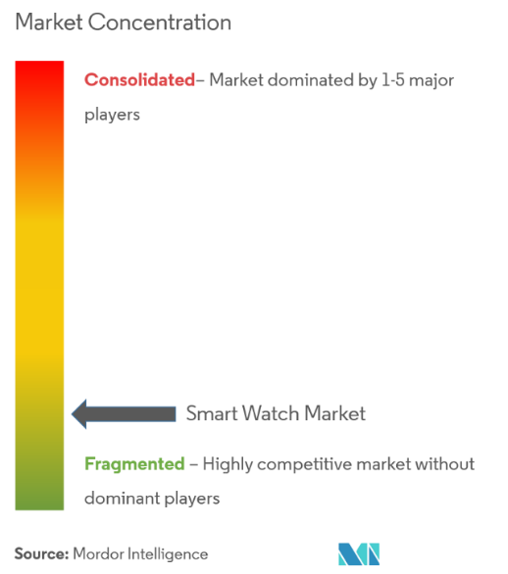
SMARTWATCH
Market Research on Sleep Tracking Devices
Examples of most well-known sleep tracking watches: ‘Apple Watch’, ‘FitBit’, ‘Galaxy Watch’, ‘Garmin’
4

Slide 6


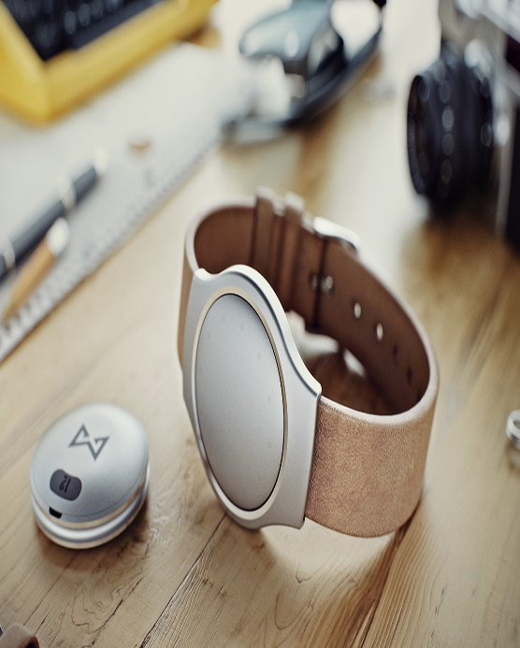



Smartwatch:
Available Functionalities
AI voice commands
Clock
Answer Calls
Record a Voice Memo
Calculator
Compass
Flashlight
Waterproof
Track user’s fitness
Track user’s health
Get Directions
Look through Photos
Send Messages
Stopwatch
Translator
Order Foods
Check News
Credit Card
Listen to Music
Smartwatch Features
Sleep Tracking : Records the duration of sleep
Alarm : sets a silent alarm with quiet vibration
Sleep Stages: Tracks light, deep and REM sleep to understand sleep quality
Sleep Schedule: Sends reminders to stay on track for a consistent routine
Sleep Insights: Get information and data about your sleeps
5

Slide 7
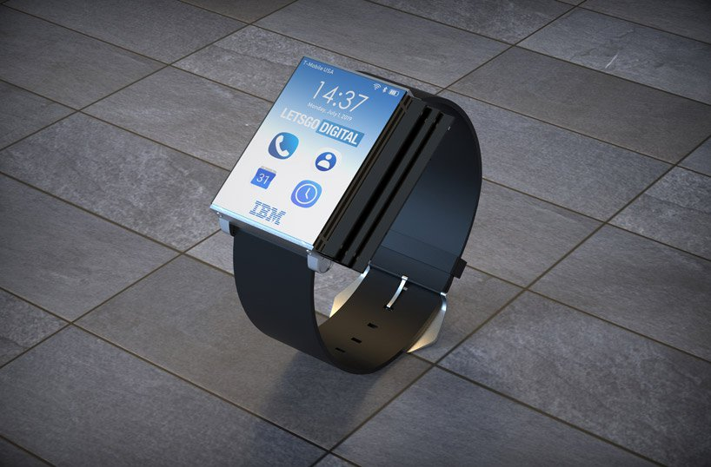
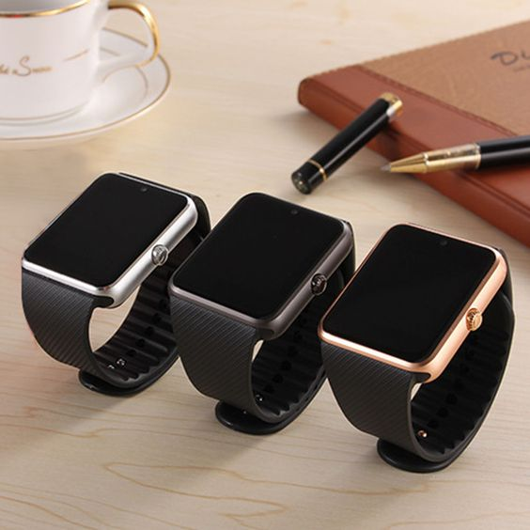
Smartwatch Cons
Battery Life / Need to Recharge
Occasional slow syncing
Need to wear a physical device in bed
Pricey
Small display area
Unless your smartwatch has the cellular capability or can connect to a Wi-Fi network, you have to be within the Bluetooth range of your smartphone to use apps
Smartwatch Pros
Small and wearable that users can carry around easily
Built in AI such as ‘Alexa’ and ‘Siri’ which allows users to give voice commands
Great number of other supported functionalities
Accurate measurements
Provides demographics
Water-resistance
Fashionable
6

Slide 8
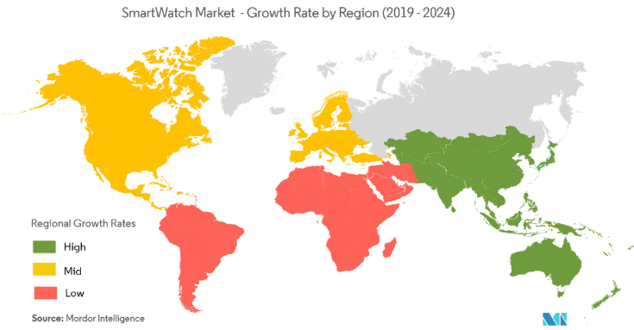
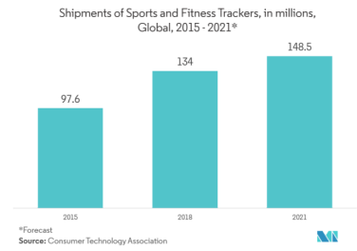
Market Analysis
Smartwatch
- According to the study conducted in 2018, smartwatch market is forecasted to increase by 14.5% by 2024.
- Current largest market is North America but the fastest growing market is Asia Pacific
- 2018 shipments volume: 43.87 million
- Estimated 2024 shipments volume: 108.91 million
- Operates as a standalone device but also with other devices such as smartphones
- Factors driving the market include:
- Increase in health awareness
- Increase in popularity of wireless devices
- Factors restraining the market include:
- Complexity of the device
- Unawareness about its utility
- In America, nearly 75% of men and 60% of women are obese or overweight. This increases the usage of smartwatches.i
In America, nearly 75% of men and 60% of women are obese or overweight. This increases the usage of smartwatches.
7

Slide 9
Smartwatch Market Future Insight
Smartwatch can assist doctors by providing significant data obtained with the watches. Doctors can easily track their patients and monitor them.Can detect seizures and alert guardians
Fitbit is working to gain clinical validation and regulatory approval for use in detecting health conditions
8

Slide 10
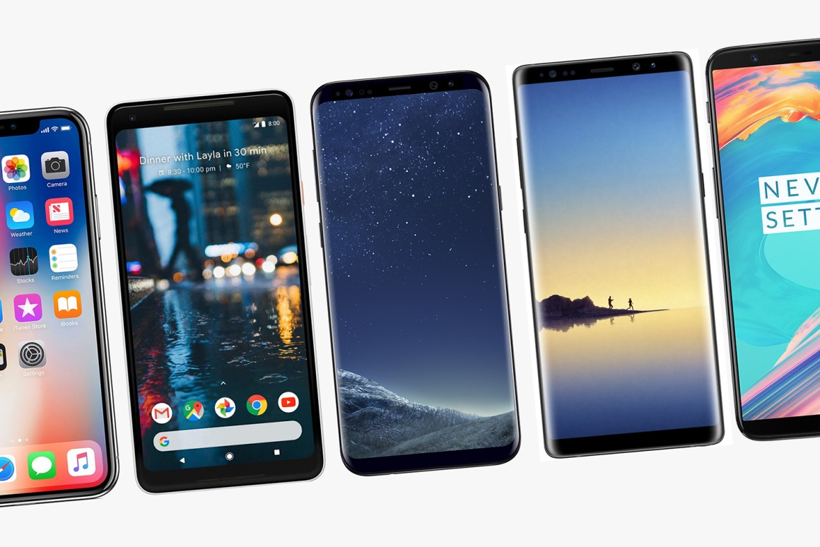
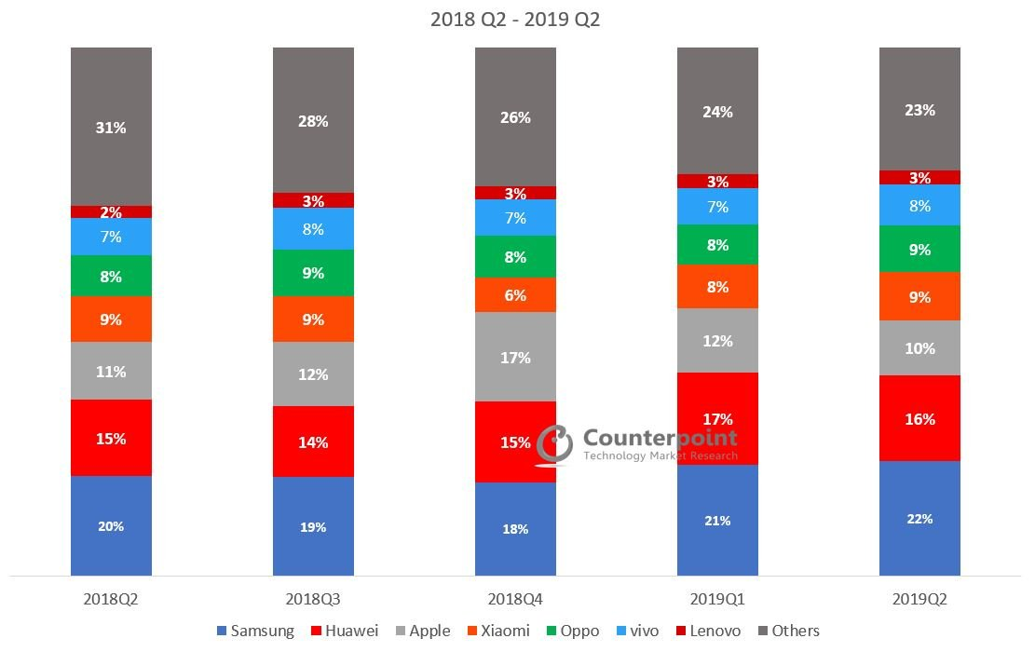
SMARTPHONE
Market Research on Sleep Tracking Devices
Key players leading the Smartphone market: Apple 、Samsung、Huawei
9

Slide 11
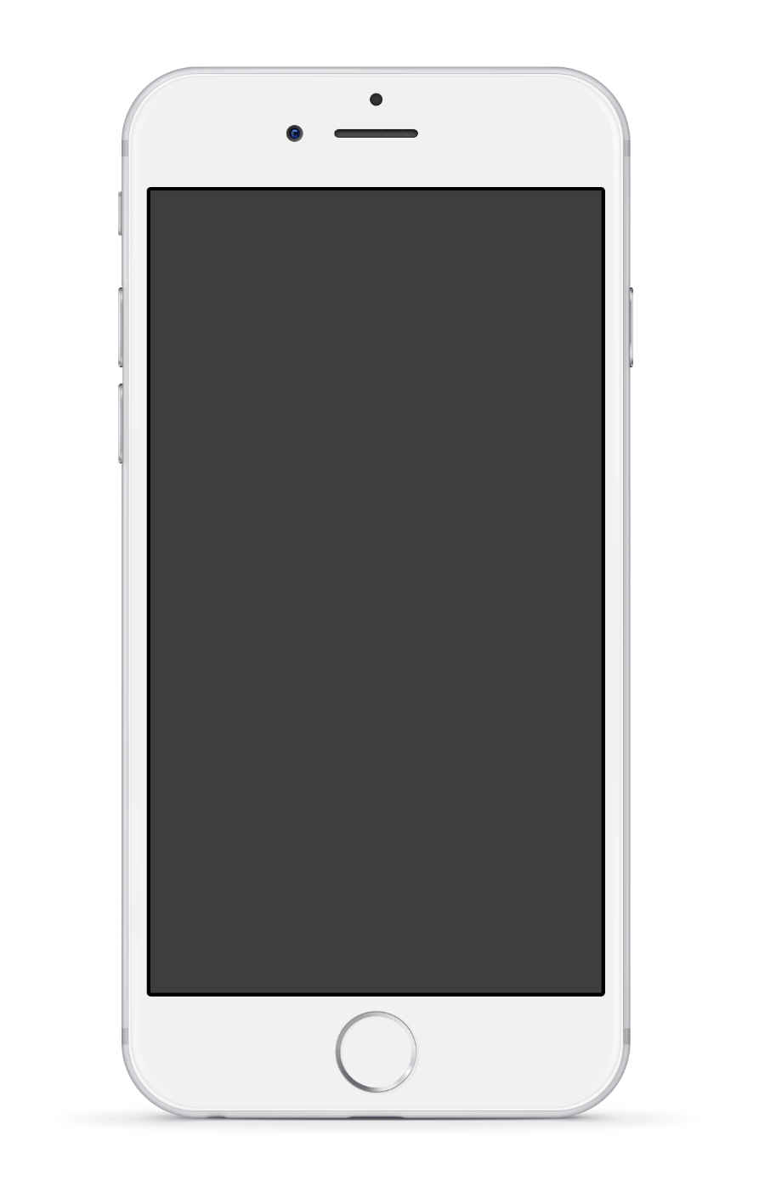
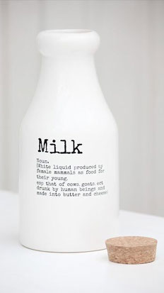
Smartphone:
Available Functionalities
AI voice commands
Alarm
Make and Answer Phone Calls
Record a Voice Memo
Calculator
Surf internet browsers
Take photos and record videos
Flashlight
Play games
Watch movies
NFC
Send and Read Messages
Translator
Order Foods
Download files
GPS
Credit Card
Listen to Music
Smartphone Features
Sleep Tracking : Records the duration of sleep & Records snoring/sleep-talks
Motion detection: Use of microphone or accelerometer to record movements
Sleep Notes: Track different activities (i.e., drinking coffee, working out) to see how it affect the user’s sleep quality
Heart Rate: Records heart rate
Alarm : wakes user up at the perfect time
Overview: Total time in bed, average time in bed, shortest night, etc.
Online Backup: Backs up data so that a user can recover lost data
Sleep Aid: Emits a soothing white noise to help users fall asleep
Wake up mood: Prompted upon awakening to record morning condition
10

Slide 12
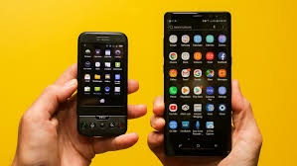
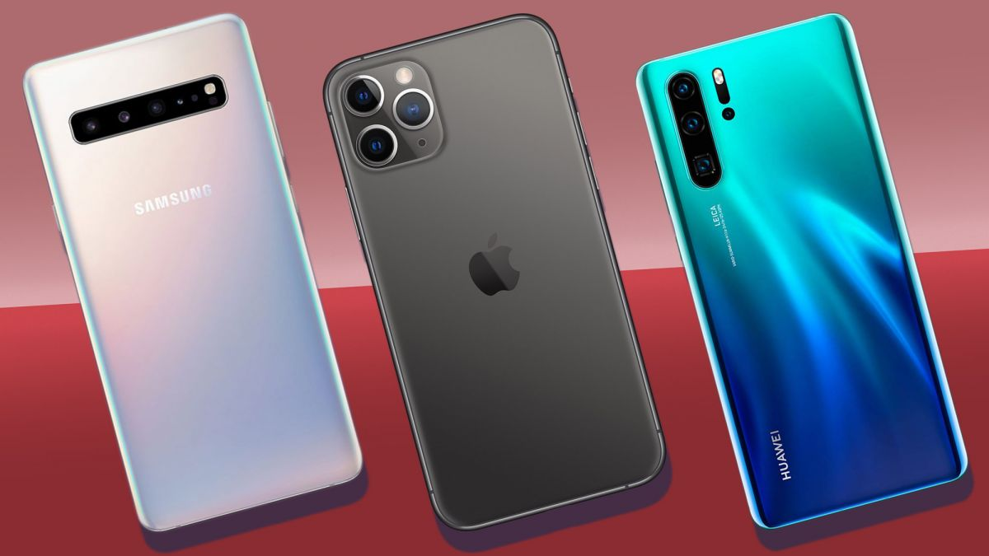
Smartphone Cons
Pricey
Overuse of smartphones lead to decreased real-life social interactions
Distracting (i.e., messages, updates, etc.)
May cause health issues (i.e., bad eyesight)
Addictive
Increase in traffic accidents (i.e., using phones while driving)
Battery Drain
Accelerometer may pick up any movements including those of pets
Smartphone Pros
Portability
Easy Access to Internet and information
Instant Communication with friends and families
Rescue for Emergencies
Capturing important moments with camera
Wide range of apps used for entertainment, education, health tracking, etc
GPS and finding ways
11

Slide 13
According to GSMA Intelligence, 80% of global mobile connections will be smartphones by 2025
Top three countries with the highest number of smartphone connections are China, India and US.
2019 smartphone sales are forecasted to be nearly 1.4 billion units
Gartner foreshadows global smartphone sales to decline by 2.5% in 2019 due to lack of replacement demands.
5G Smartphone launching hope to stop the declining sales. 18 countries are expected to have launched 5G networks by the end of 2019.
Continuous focus in AI development to aid user experience
Smartphone
Market
12

Slide 14
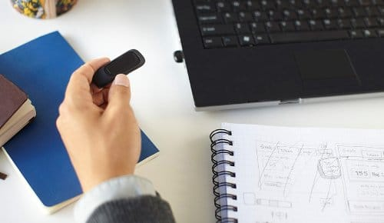
WIRELESS
ACTIVITY TRACKER
Market Research on Sleep Tracking Devices
One powerful, insightful tracker.
All-Day Activity
1
Track steps,floors climbed,distance,calories burned ＆actvice minutes.
Clock+Display
2
See daily stats＆time of day on the OLED display
Sleep+Alarms
3
Monitor how long and how well you sleep＆wake with a silent alarm
Wireless Syncing
4
Daily activity stats will automatically sync to your phone, tablet or computer
13

Slide 15
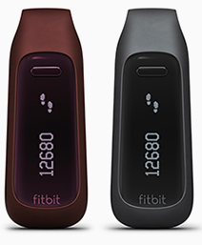
Features
SEE PROGRESS
RECORD WORKOUTS
View your progress and analyze your trends with easy-to-read charts and graphs
Log workouts, see a monthly exercise calendar＆use .MobileRun to track run stats and map routes
SHARE+CMPETE
EARN BADGES
Invite friend and family to share stats, send cheers＆compete on the leaderboard
Get goal progress notifications ＆celebrate fitness milestones with badges
LOG FOOD
SLEEP BETTER
Log food fast with a calorie estimator,meal shortcuts＆ expanded food database
Set sleep goals,review sleep quality ＆see weekly sleep trend graphs
14

Slide 16
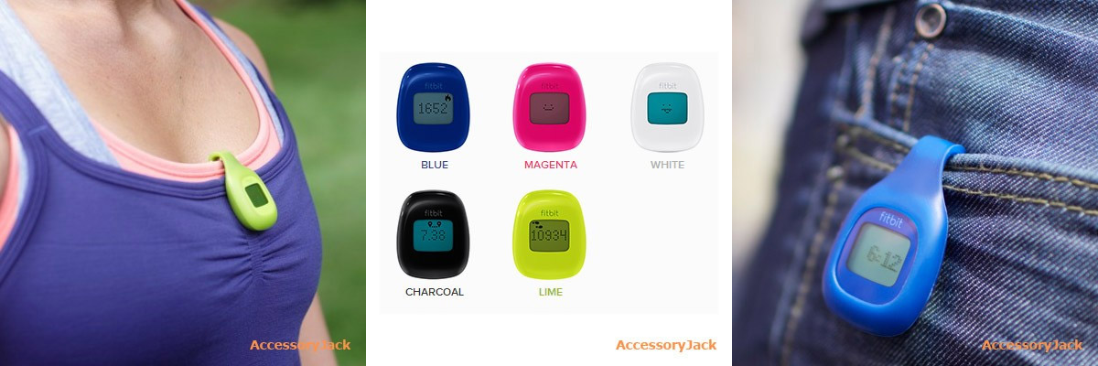
Wireless Activity Tracker Pros
Wireless Activity Tracker Cons
Has an altimeter to measure stair climbing
Has a display with 6 tracking modes
Features a clock on its display
Accuracy and durability rated high by users
Measures sleep quality
Vibrating silent alarm will not cause disturbance
Ability to connect to online community is highly motivating
Can set either miles or kilometers for distance units
Easy to set up and program
Wireless syncing of latest stats
Compatible with PCs and Macs, iOS and Android devices
Compatible with many other fitness apps available
Ability to connect with online fitness communities
Small, light and discreet
Great motivational tool to become more active and healthy
No GPS tracking
Sleep wristband comes undone and tracker often slips out
Silicone case with clip tends to loosen over time and tracker falls out
Sometimes counts steps while driving on bumpy roads
Display hard to read in bright sunlight
Need to manually enter activities not tracked
Not waterproof
15

Slide 17
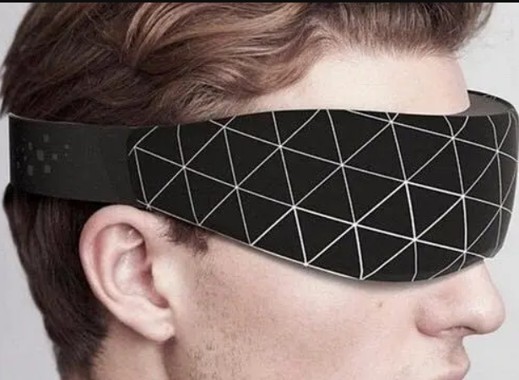
SLEEP MASK
Market Research on Sleep Tracking Devices
Sleep Mask lets you monitor your brain activity whilst asleep.
Neuroon was originally a product focussed on aiding polyphasic sleep (breaking your sleep up into a series of timed naps) but after consulting with the medical and business community, the founders decided to pivot their idea to benefit a wider audience, transforming their device into a ‘universal sleep companion’ and ‘personal energy manager’.
Features
Sleep issues (insomnia, fatigue, trouble falling asleep)
Jet lag
Shift working/irregular schedules
‘Smart’ napping
Lucid dreaming (available as an additional add-on)
16

Slide 18
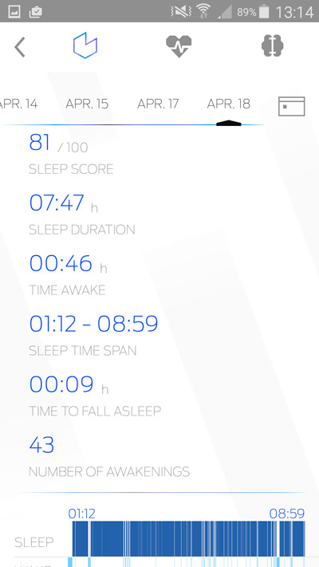
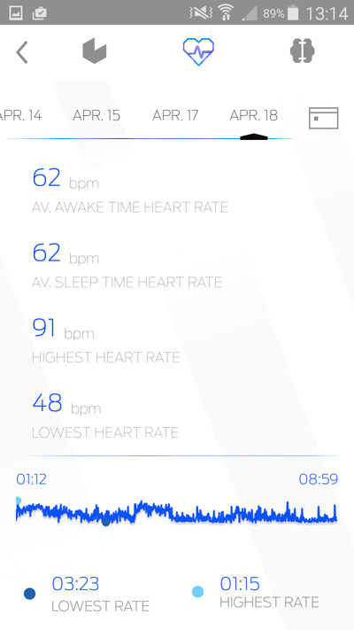
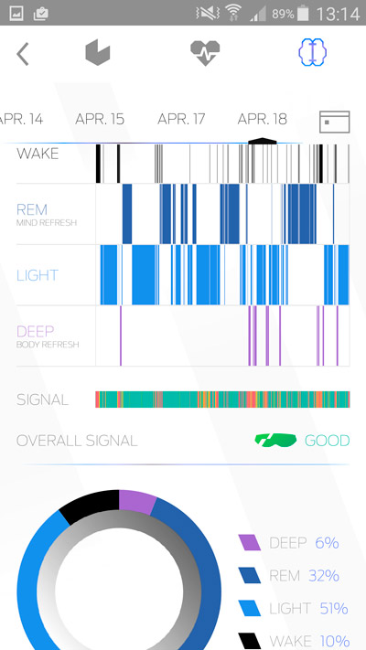
Features of an App Compatible with Sleep Mask
Sleep duration
Heart rate
Rem/Sleep staging
Sleep score
Sleep duration
Time awake
Sleep time span (start/end of your sleep)
Time to fall asleep
Number of awakenings
Average awake time heart rate
Average sleep time heart rate
Highest heart rate
Lowest heart rate
Time of lowest/highest heart rate
Wake
REM
Light
Deep
17

Slide 19
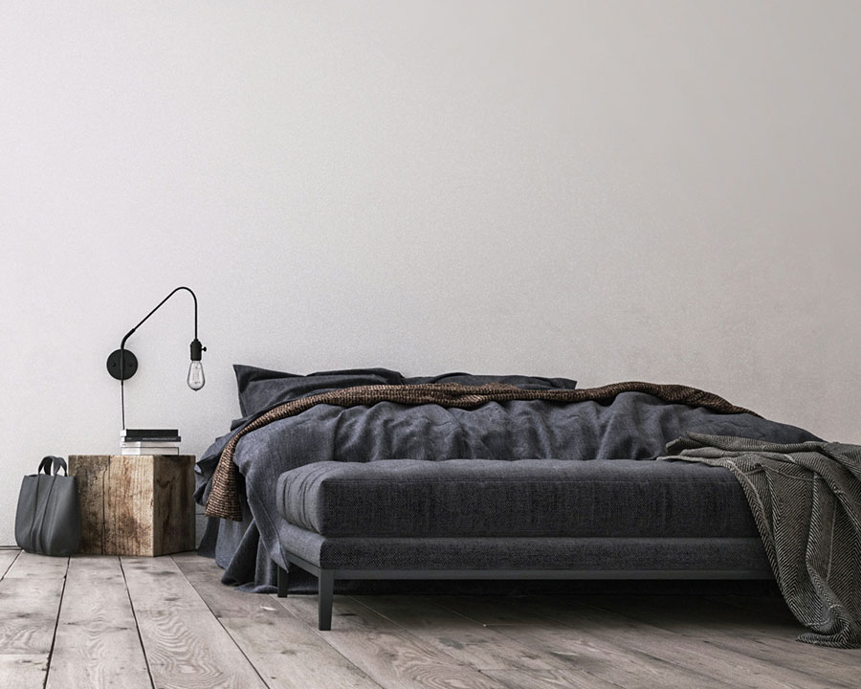
SLEEP MASK PRO
Unique EEG (brainwave) sensing technology
Measures REM sleep
Sensors and algorithms measure a wide range of bio-signals
Can help with jet-lag, shift-work and lucid dreaming
Compact and light – good for travelling
API coming in the future
SLEEP MASK CONS
Technology is let down by sub-optimal product design
No ‘smart’ alarm feature to wake you in light sleep
No data sharing or IoT integration at present
Battery life is disappointing
18

Slide 20
02
Application
Advantages and disadvantages of the application, functional analysis
19

Slide 21
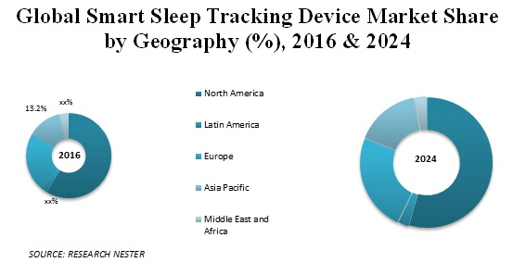
Of Sleep Tracking Devices
Overall Market Analysis
The smart sleep tracking device market in 2016 was $1.1125 billion and is expected to grow at a compound annual growth rate of 18.5% during the forecast period. People are increasingly aware of the need to check and adjust their sleep patterns. More and more sleep-related health problems such as obesity and leg restlessness syndrome have prompted consumers to adopt sleep tracking devices.
The global smart sleep tracking device market is divided into wearable and non-wearable devices by product type. The wearable device segment (74.1% share in 2016) dominates the world's largest smart sleep tracking device market. According to geographic regions, the global smart sleep tracking device market is divided into five main regions, including North America, Europe, Asia Pacific, Latin America, and the Middle East and Africa.
20

Slide 22
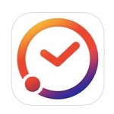
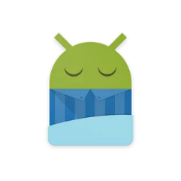
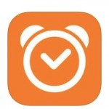
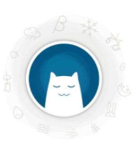

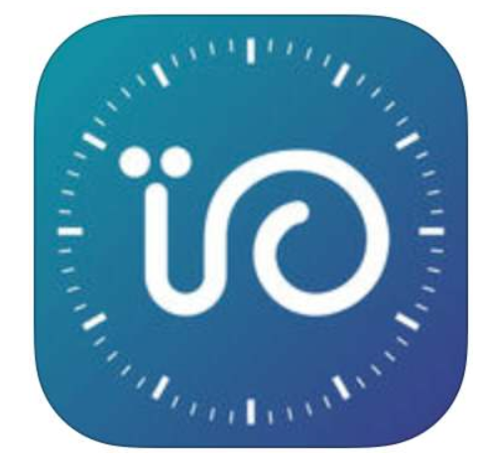
App analysis
SLEEP CYCLE
SLEEP TIME
SLEEP AS ANDROID
小睡眠
WONIU SLEEP
潮汐
21

Slide 23
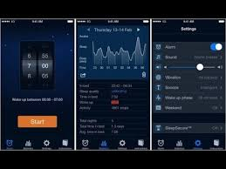
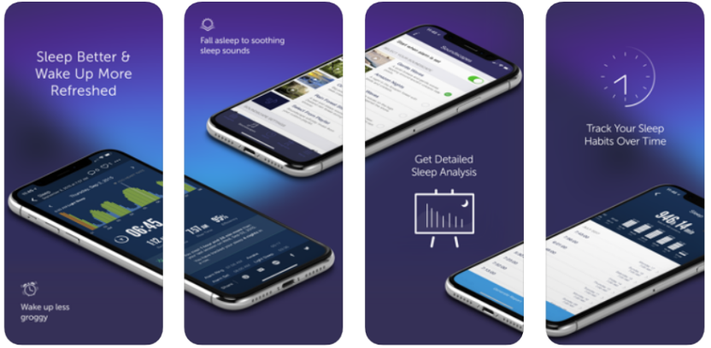
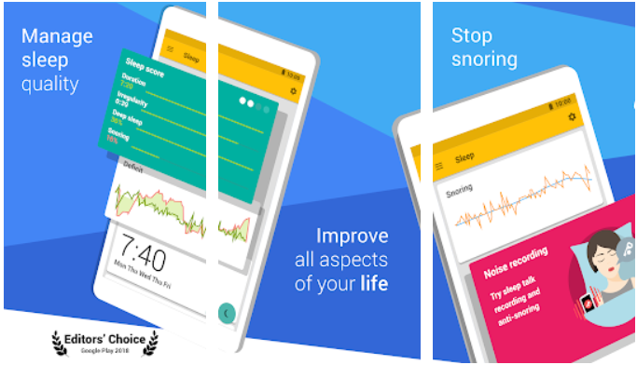
SLEEP CYCLE
ANDROID | iOS
4.5 / 5 ★ (96k reviews) 5+ Million Downloads In-app Purchases | 4.6 / 5 ★ (28k reviews) Editors’ Choice #21 in Health & Fitness category In-app Purchases
SLEEP TIME
ANDROID | iOS
3.8 / 5 ★ (31k reviews) 1+ Million Downloads In-app Purchases | 4.7 / 5 ★ (4k reviews) Editors’ Choice #21 in Health & Fitness category In-app Purchases
SLEEP AS ANDROID
ANDROID | iOS
4.6 / 5 ★ (299k reviews) 10+ Million Downloads In-app Purchases | Not Available
22

Slide 24
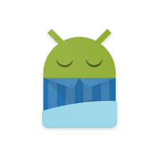
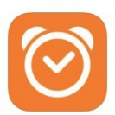
Notable Features
SLEEP CYCLE
SLEEP TIME
SLEEP AS ANDROID
Sleep cycle tracking: Uses phone or wearable’s sensors
Sonar: Contact-less ultrasonic sleep tracking (no need for phone in bed)
Sleep Score: Analysis of sleep quality based on duration, deep sleep %, snoring, etc.
Compatibility: Compatible with wearable tracking such as Pebble, Wear OS, Galaxy Gear, Garmin, Mi Band
Alarms: Gentle nature sound alarms (i.e., birds, sea, storm, etc.) and playlists
Lullabies: Nature sound lullabies (i.e., whales, storm, sea, etc.)
Recording: Records sleep talks, detects snoring and also have an anti-snoring feature
Jet lag Prevention: aids users with overcoming jet lag
.
Alarm Clock: Uses sound to analyze movements and sleep states. Will monitor signals from user’s body to wake them up softly at the lightest sleep stage within the customizable 90 min wake-up phase. Can wake up with the song of user’s choice
Motion Detection: Microphone: Uses sound to detect movements as the user sleeps
Accelerometer: Records movements on bed as the user sleeps
Statistics: Sleep quality shown as easy-to-read percentage and graphs
Sleep Notes: Records what the user did before going to bed to keep track of habits that result in high or low quality of sleep
Monthly/Weekly Graphs: Visually tracks sleep data
Soundscapes / White Noise: Fall asleep listening to noises that help users fall asleep
Alarm: Link to user’s iTunes or wake up with 20 built-in app alarm
Compatibility: Compatible with Apple Health
Statistics: Full history of stats
Pulse Recording: Detects user’s pulse immediately after waking up
Tags: Before going to sleep, user is prompted to tag the night with tages such as ‘not in your own bed’, ‘ate late’, ‘alcohol’, etc.
23

Slide 25
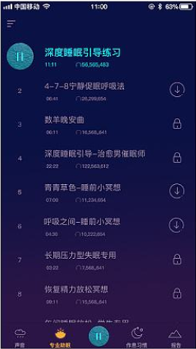
小睡眠
Target Customers:
1. People who have sleep problems and want to improve their sleep quality
2. People who value health including who may not have a sleep problem
Product Features:
1. Professional sleep aid, good night radio, help users fall asleep, improve sleep quality
2. Sleep encyclopedia, psychological test to help users understand more health information
3. Alarm clock, habit training, heart rate test, help users manage health
Pros:
1. High quality and rich sound resources: professional type sleep audio
2. Beautiful visual design: soft color, low saturation and sleep scene
3. Social mode, users can share audio + a short paragraph of text in the sound community
4. The quality of the radio content is high.
24

Slide 26
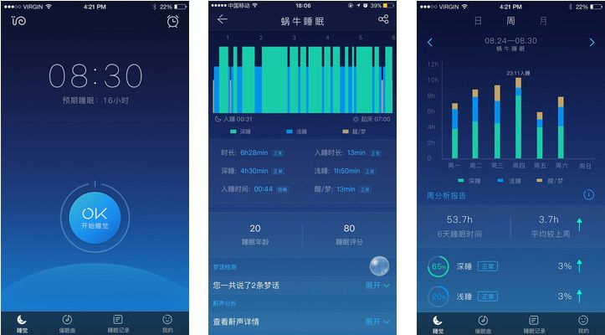
WONIU SLEEP
Features
Can monitor recording dreams
Sleep analysis
Deep period
Number of hits
Turn over
Sleep age
25

Slide 27
WONIU SLEEP
Pros
A) functionality:
1. The audio is very rich and professional. The sleep aid interface is divided into four tabs, and each tab has a more detailed category to meet the user's multiple sound requirements.
-- Natural tone tab, can have multiple audio overlays, the interaction is lit, the experience is very good, and the top right corner uses the background to highlight the volume adjustment and timing functions.
--- Story tab, the quality of the story is high
2. The sleep words in the sleep report, the unfolding function does not respond, but the data analysis is detailed and the algorithm is accurate.
B ) interface:
1. The pop-in and stop of the sleep state is the diffusion and contraction of the prototype, which is in line with the scene experience of opening and closing;
Long press and stop the countdown is very interesting, humanized
Starry sky and play scrolling are very suitable for quiet and sleepy scenes, and also consider the need to open the phone all night, there will be eye-catching power prompts;
2. The mall tab interface is doing very well, the left and right information and the shopping cart are hidden.
26

Slide 28
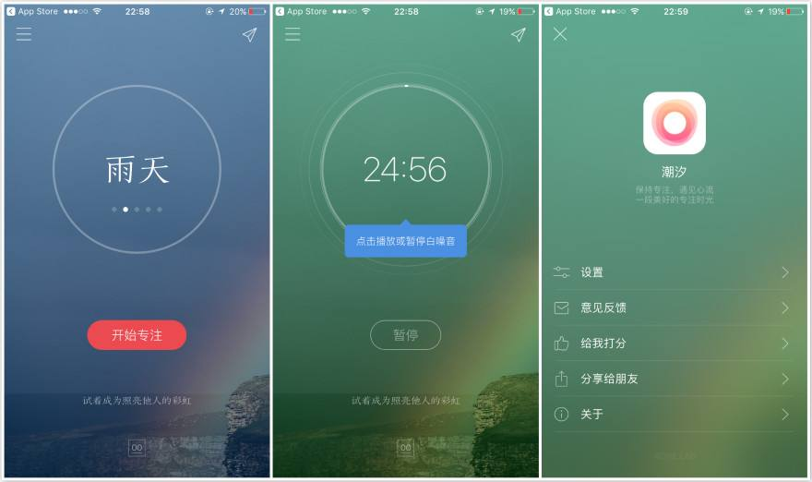
WONIU SLEEP
Pros
Future Insights:
The function of ChaoxiAPP is more perfect than the similar ones and introduces the concept of tomato clock, which attracts a large wave of students and creative staff. At the same time, different greetings and background images of the day give people a feeling of being cared and paying attention to the emotions of the users.
Because APP has more comprehensive functions and a group of loyal users based on white noise tomato clock, it should simplify the function operation path, perfect function points, maximize the advantages of combining the tomato clock, and highlight this function.
Cons
Threat
Chaoxi APP has fewer scenes to choose from, the product has weak playability, and the product operation path is too deep.
There are many similar white noise applications on the market, small sleeps that focus on sleep, taomix 2 that cares about rest and sleep, etc., and their playability is stronger than the tide.
27

Slide 29
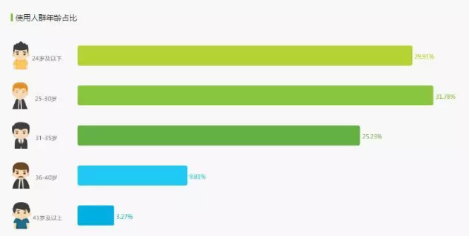
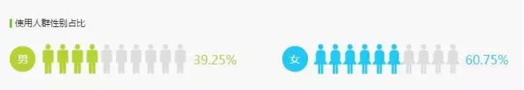
Smartphone Sleep App Market Survey Results
User gender, age, etc.
User gender:
The use of users is mainly female, accounting for 60.75%, while male users only account for 39.25%.
User age:
Users are mainly composed of 25-30 years old, accounting for 29.91%, accounting for 29.91% under 24 years old, 25.23% for 31-35 years old, and relatively few groups of 36-49 years old and 41 years old, only 9.81% and 3.27% respectively.
28

Slide 30
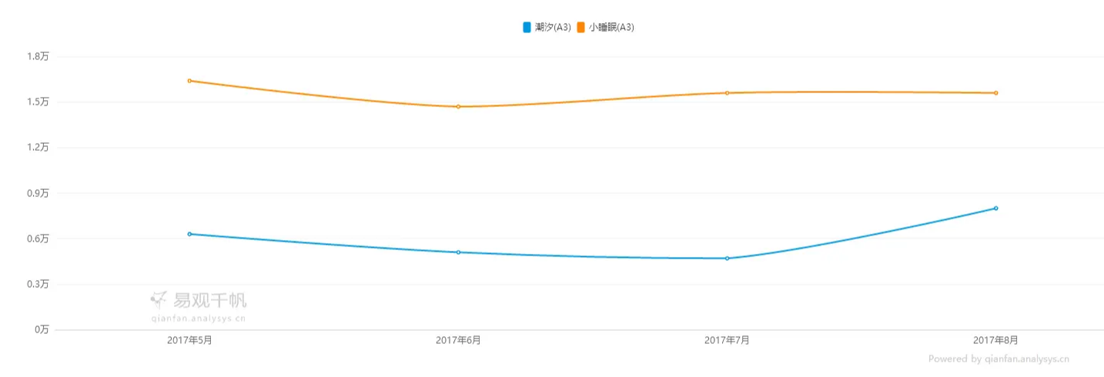
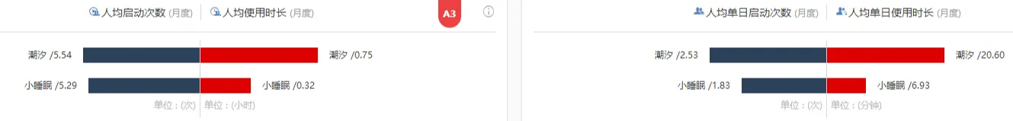
User size
User stickiness
This market is a niche market and there are not many active people. At the same time, the active users of small sleep are about 2-3 times of the tide, which is related to the free business mode of small sleep and more grounding. The music scene of small sleep is more, and its gameplay is more diverse and can adapt to different ages. The user, while the tide of free music scenes is relatively small, which also caused the users of small sleep far more than the tide.
The number of starts per person in the tide is slightly ahead of the small sleep, which is related to the positioning of the tide. The tides subdivide the user scene and introduce the concept of the tomato work method, which increases the chance of users opening the use. While small sleep is more focused on sleep, it is usually used at noon or at night, and the daily average of 1.83 is in line with user behavior.
29

Slide 31
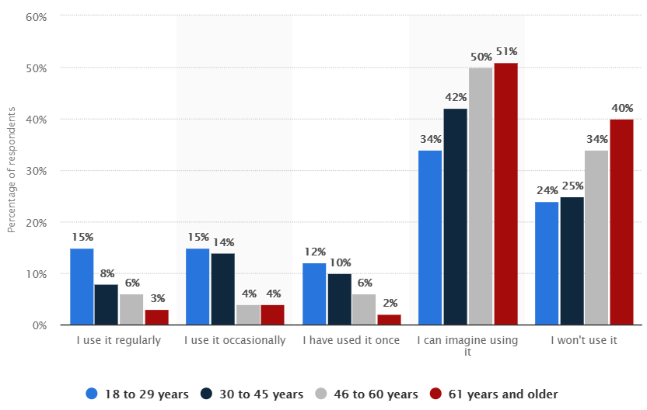
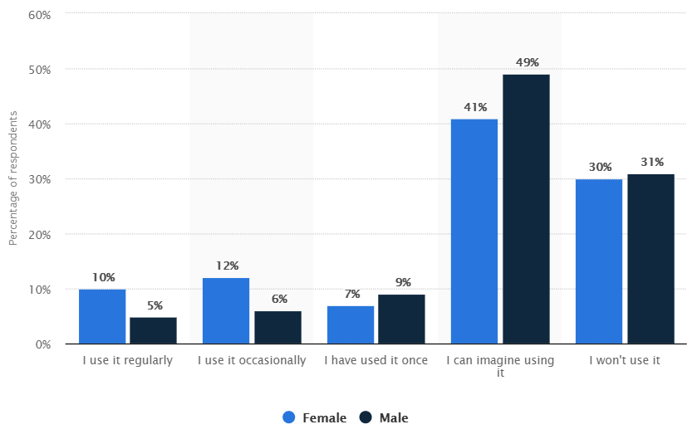
User Demographics
Of US Citizens
Age of US adults that used Sleep Tracking Apps
Gender of US adults that used Sleep Tracking Apps
15% of respondents aged 18~29 years regularly use a sleep tracking app
3% of respondents aged 61+ years regularly use a sleep tracking app
10% of females responded that they regularly use a sleep tracking app
Only 5% of males responded that they regularly use a sleep tracking app
30

Slide 32
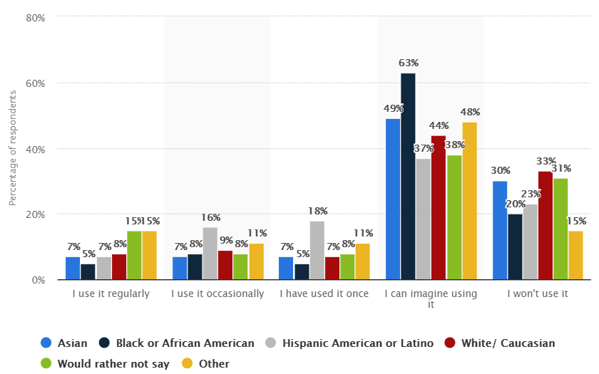
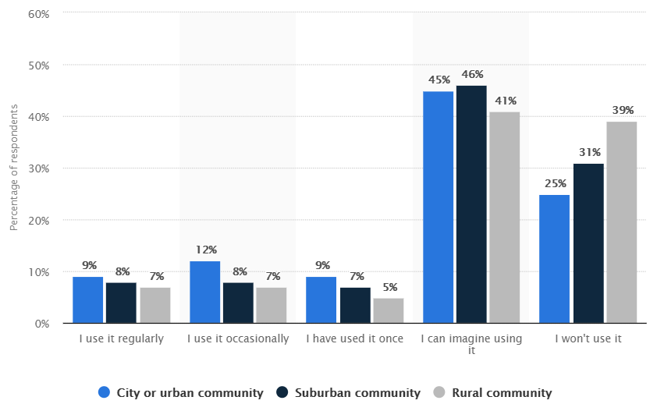
User Demographics
Of US Citizens
Ethnicity of US adults that used Sleep Tracking Apps
Community of US adults that used Sleep Tracking Apps
In total, 7% of Asian and Hispanic American or Latino respondents indicated that they regularly use sleep tracking apps
12% of people in city or urban communities occasionally use sleep tracking apps
7% of people in rural communities occasionally use sleep tracking apps
31

Slide 33
03
Heuristic Evaluation
Expert Analysis On Several Sleeping Apps
32

Slide 34
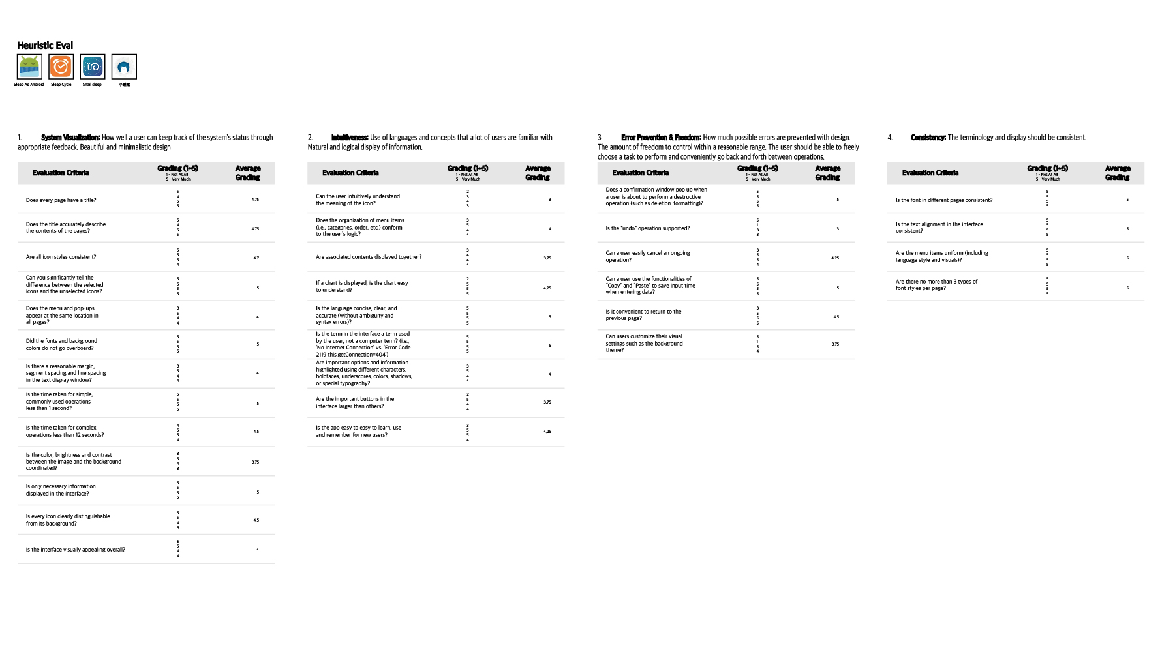
33

Slide 35

34

Slide 36

35

Slide 37
04
User Tests
User Tests on 'Sleep As Android' App
36

Slide 38


User Demographics
Pre-questionnaire Results
User #1: Kei Hsu
Level: Beginner
- Used a sleeping app before
- Have not used it because I know I wouldn't be able to use it consistently, so I'd rather not start.
- I am interested in sleeping apps to see how well/not well I sleep in a night and hopefully improve myself
- I identify my skill level with using smartphones (i.e., learning how to use new apps quickly, knowledge of universal icons such as trash can icon referring to delete button)
as 7/7
User #2: Ming Aimpawee
Level: Expert
- Uses sleeping app everyday
- Used a sleeping app called 'Sleep Cycle'
- I am interested in sleeping apps because I am curious on my sleeping cycle
- I identify my skill level with using smartphones (i.e., learning how to use new apps quickly, knowledge of universal icons such as trash can icon referring to delete button) as 6/7
37

Slide 39





Task 1
Start sleep tracking
Task 2
Turn on a lullaby called 'Whale
Diving,' listen to it for 5 secs then stop the noise
Task 3
Stop sleep tracking and delete its sleep record. Then undo the deletion
Task 4
Change the app to a darker colour theme
Task 5
Listen to one of the recorded sounds that the user made during sleeping
38

Slide 40





Task 6
Add an alarm named 'School' that goes off every Tues and Thurs at 8 AM
Task 7
Set the sleep noise recording volume to max
Task 8
Set a notification that tells the user 15 mins before bedtime
Task 9
Find out which day the user snored and which day the user had a bad dream
Task 10
Find out how much deep sleep the user got on Monday, Nov. 25th
39

Slide 41
User Test Clips
- https://youtu.be/71eY-1arEnw
- https://youtu.be/iydtBhnpe2s
User Test Results
Kei
Ming
 | Time Took to Complete the Task | Think Aloud | Analysis
Task 1 Start sleep tracking | 00:05.00 | There you go | No issues.
 | 00:06.00 | Okay
Task 2 Turn on a lullaby called 'Whale Diving,' listen to it for 5 secs then stop the noise | 00:32.00 | Uhh, here it is | User 'Ming' had trouble locating the lullaby icon. Both mistook the pause button for stopping the lullaby, whereas it was for pausing the sleep record
 | 00:43.00 | Where is the lullaby? I can't find it
Task 3 Stop sleep tracking and delete its sleep record. Then undo the deletion | 00:11.00 | Stop.. Done | No issues.
 | 00:15.00 | You want to delete this? Sure, delete. Undo.
Task 4 Change the app to a darker colour theme | 00:35.00 | Miscellaneous! | User 'Ming' had trouble finding the settings for changing the colour theme.
 | 01:00.00 | It's the same thing! Whoo! Smartlight? Oh! Night Owl, I like that.
Task 5 Listen to one of the recorded sounds that the user made during sleeping | 02:09.00 | Weird.. It doesn't show up even if I find it. | Both users could not notice the menu button for a while.
 | 05:11.00 | Umm.. It's not here.. Sleep tracking.. I cannot find it. Sleep noise recording..? Sleep recording? Mm... I might take forever. By the way I like how there's many functions
40

Slide 42
User Test Clips
- https://youtu.be/71eY-1arEnw
- https://youtu.be/iydtBhnpe2s
User Test Results
Kei
Ming
 | Time Took to Complete the Task | Think Aloud | Analysis
Task 6 Add an alarm named 'School' that goes off every Tues and Thurs at 8 AM | 00:28.00 | This is pretty straight forward. School right? When was it? | No issues.
 | 00:40.00 | 8.. oh, it's AM sorry. Name school...
Task 7 Set the sleep noise recording volume to max | 00:18.00 | Uhh did I do this right? | No issues.
 | 00:25.00 | Set the sleep noise.. To max?
Task 8 Set a notification that tells the user 15 mins before bedtime | 00:14.00 | Notification.. Oh it's right here. | No issues.
 | 00:09.00 | It's pretty similar to the one I used before, so..
Task 9 Find out which day the user snored and which day the user had a bad dream | 01:30.00 | Oh is the saw icon for snoring because it makes sound? | Icon is not intuitive. It is difficult to understand the meaning of the icons.
 | 02:43.00 | I can do that? The one with the saw is the sound and the one that looks like the ghost is the bad dream
Task 10 Find out how much deep sleep the user got On Monday, Nov. 25th | 00:09.00 | 58%? | No issues.
 | 00:17.00 | Monday.. November.. 58%.
41

Slide 43




#4:
- The pause button on the sleep recording page is mistaken as a button for stopping the lullaby. In fact, it is for extending the start time of sleep recording.
User Test Results Summary
#1:
- Both expert and beginner user faced the same problems. In fact, beginner user completed the tasks faster. No significant time difference
were noted between the users.
#2:
- Task 2, 4, 5 and 9 were problematic.
#5:
- It takes a long time to notice the presence of a menu button.
#3:
- The stop button for the lullaby is in the lullaby pop up window but it is not noticeable.
#6:
- Icons are not intuitive. They are very difficult to understand.
42

Slide 44

User Test Post-Questionnaire
System Visuals:
- 168/196 = 85.7%
Consistency:
- 55/56 = 98.2%
Intuitiveness:
- 99/126 = 78.6%
Overall Impression:
- 8/10 = 80.0%
Error Prevention & Freedom:
- 70/98 = 71.4%
Easiest Task:
- Start sleep tracking
Most Difficult Task:
- Find out which day the user snored and which day the user had a bad dream
Best Quality of the App:
- Details of the sleep
- Various features and functionalities
Worst Quality of the App:
- Icon's intuitiveness
43

Slide 45
05
App Planning
Ideas for customized sleeping app
44

Slide 46
Features
Features to Keep
- Graphical representation of data
- Sleep recording
- Custom alarms
- White noise / lullaby
- Sleep noise recording (I.e., snoring, sleep talking, etc.)
New Features to Add
- Connection and control over user's pillow
- Diet recommendation that helps the user's sleep quality
Features to Remove
- Weekly report
- Sharing data with people
45

Slide 47

46

Slide 48

47

Slide 49

48

Slide 50

49

Slide 51

50

Slide 52

51

Slide 53

52

Slide 54

53

Slide 55


